Slide 1

Client-Server Communication
Lesson 13 – dong, bui huu

Slide 2
Objectives
Set up a simple server that makes data available for clients
Access the data from the server using a browser
Use the json-server as a simple static web server

Slide 3

Networking Essentials

Slide 4
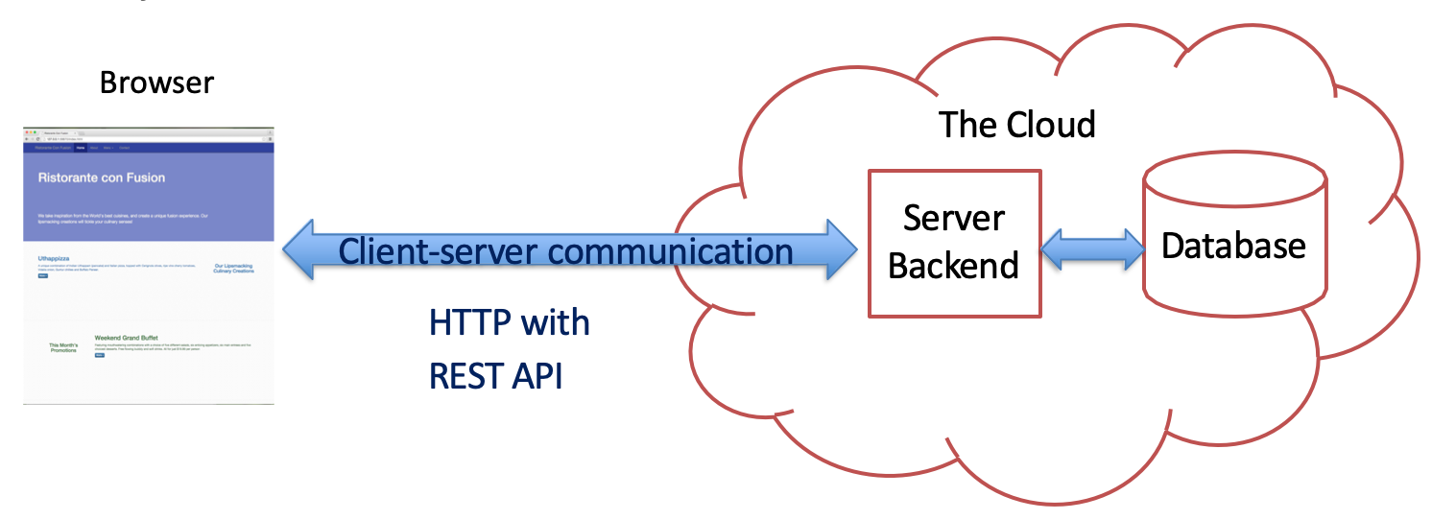
Client and Server
Web applications are not stand-alone
Many of them have a “Cloud” backend

Slide 5
Client-Server Communication
Network operations cause unexpected delays
You need to write applications recognizing the asynchronous nature of communication
Data is not instantaneously available

Slide 6
Hypertext Transfer Protocol (HTTP)
A client-server communications protocol
Allows retrieving inter-linked text documents (hypertext)
World Wide Web.
HTTP Verbs
HEAD
GET
POST
PUT
DELETE
TRACE
OPTIONS
CONNECT

Slide 7
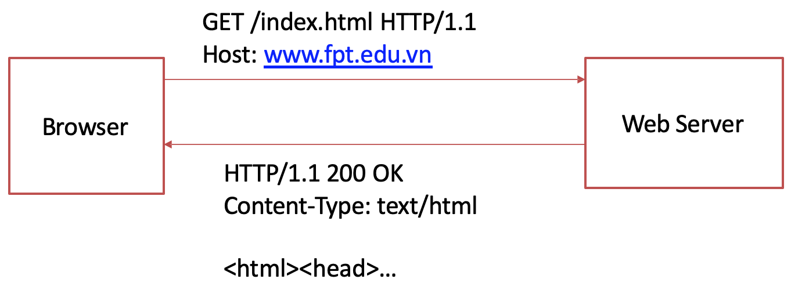
Hypertext Transfer Protocol (HTTP)

Slide 8
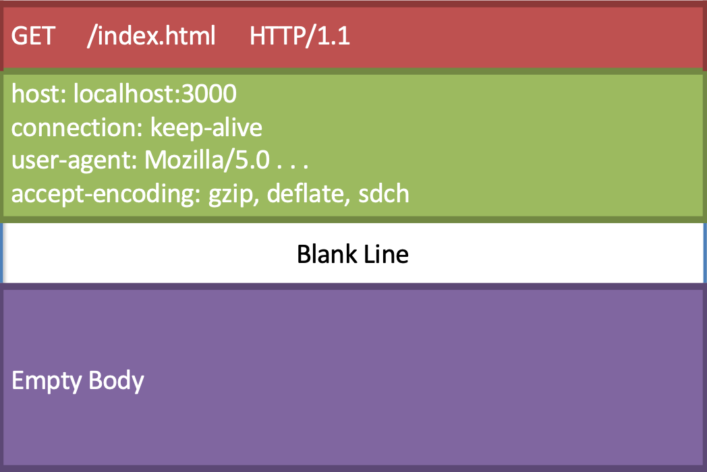
HTTP Request Message

Slide 9
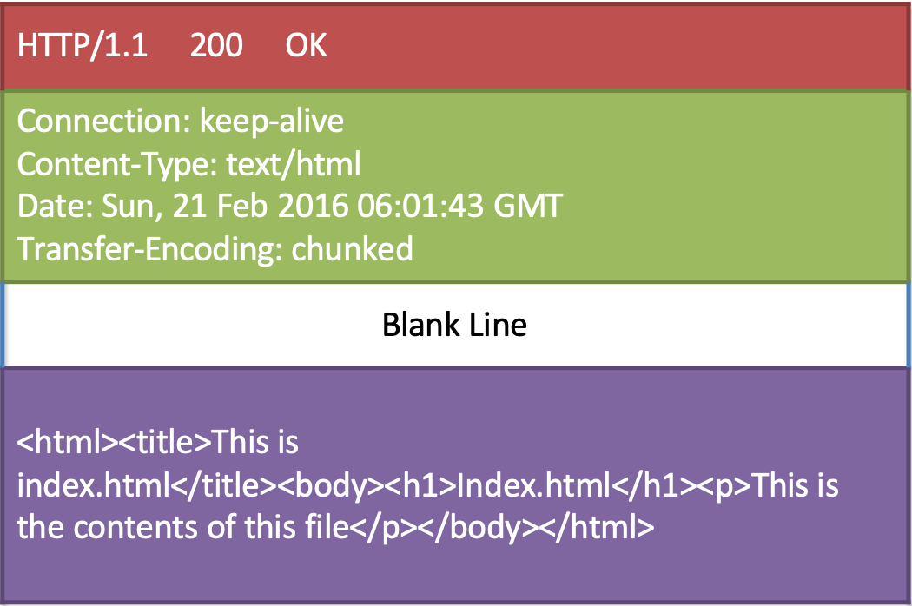
HTTP Response Message

Slide 10
HTTP Response Codes (Main ones)
Code | Meaning
200 | OK
201 | Created
301 | Moved Permanently
304 | Not Modified
400 | Bad Request
401 | Unauthorized
403 | Forbidden
404 | Not Found
422 | Unprocessable Entry
500 | Internal Server Error
505 | HTTP Version Not Supported

Slide 11
HTTP Response
Server may send back data in a specific format:
eXtensible Markup Language (XML)
Javascript Object Notation (JSON)

Slide 12
Javascript Object Notation (JSON)
http://www.json.org
Lightweight data interchange format
Language independent *
Self-describing and easy to understand

Slide 13
Javascript Object Notation (JSON)
Data structured as:
A collection of name/value pairs
Ordered list of values
– Example
{ "promotions": [
{
"id": 0,
"name": "Weekend Grand Buffet", "image": "images/buffet.png", "label": "New",
"price": "19.99",
"description": "Featuring mouthwatering combinations . . . "
}
]
}

Slide 14
Brief Representational State Transfer (REST)

Slide 15
Web Services
A system designed to support interoperability of systems connected over a network
Service oriented architecture (SOA)
A standardized way of integrating web-based applications using open standards operating over the Internet
Two common approaches used in practice:
SOAP (Simple Object Access Protocol) based services
Uses WSDL (Web Services Description Language)
XML based
REST (Representational State Transfer)
Use Web standards
Exchange of data using either XML or JSON
Simpler compared to SOAP, WSDL etc.

Slide 16
Representational State Transfer (REST)
A style of software architecture for distributed hypermedia systems such as the World Wide Web.
Introduced in the doctoral dissertation of Roy Fielding
One of the principal authors of the HTTP specification.
A collection of network architecture principles which outline how resources are defined and addressed

Slide 17
Representational State Transfer (REST)
Four basic design principles:
Use HTTP methods explicitly
Be stateless
Expose directory structure-like URIs
Transfer using XML, JavaScript Object Notation (JSON), or both

Slide 18
REST and HTTP
The motivation for REST was to capture the characteristics of the Web that made the Web successful
URI (Uniform Resource Indicator) Addressable resources
HTTP Protocol
Make a Request – Receive Response – Display Response
Exploits the use of the HTTP protocol beyond HTTP POST and HTTP GET
HTTP PUT, HTTP DELETE
Preserve Idempotence

Slide 19
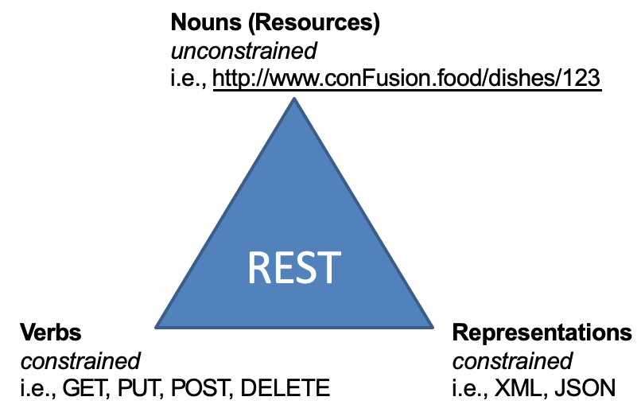
REST Concepts

Slide 20
Resources
The key abstraction of information in REST is a resource.
A resource is a conceptual mapping to a set of entities
Any information that can be named can be a resource: a document or image, a temporal service (e.g. "today's weather in Hong Kong"), a collection of other resources, a non-virtual object (e.g. a person), and so on
Represented with a global identifier (URI in HTTP)
http://www.conFusion.food/dishes/123

Slide 21
Naming Resources
REST uses URI to identify resources
http://www.conFusion.food/dishes/
http://www.conFusion.food/dishes/123
http://www.conFusion.food/promotions/
http://www.conFusion.food/leadership/
http://www.conFusion.food/leadership/456
As you traverse the path from more generic to more specific, you are navigating the data
Directory structure to identify resources

Slide 22
Verbs
Represent the actions to be performed on resources
Corresponding to the CRUD operations
HTTP GET → READ
HTTP POST → CREATE
HTTP PUT → UPDATE
HTTP DELETE → DELETE

Slide 23
HTTP GET
Used by clients to request for information
Issuing a GET request transfers the data from the server to the client in some representation (XML, JSON)
GET http://www.conFusion.food/dishes/
Retrieve all dishes
GET http://www.conFusion.food/dishes/452
Retrieve information about the specific dish

Slide 24
HTTP PUT, HTTP POST, HTTP DELETE
HTTP POST creates a resource
POST http://www.conFusion.food/feedback/
Content: {first name, last name, email, comment etc.}
Creates a new feedback with given properties
HTTP PUT updates a resource
PUT http://www.conFusion.food/dishes/123
Content: {name, image, description, comments …}
Updates the information about the dish, e.g., comments
HTTP DELETE removes the resource identified by the URI
DELETE http://www.conFusion.food/dishes/456
Delete the specified dish

Slide 25
Representations
How data is represented or returned to the client for presentation
Two main formats:
JavaScript Object Notation (JSON)
XML
It is common to have multiple representations of the same data
Client can request the data in a specific format if supported

Slide 26
Stateless Server
Server side should not track the client state:
Every request is a new request from the client
Client side should track its own state:
E.g., using cookies, client-side database
Every request must include sufficient information for server to serve up the requested information
Client-side MVC setup

Slide 27
Exercise 18: Setting up a Server using json-server
Configure and start a simple server using the json-server module
Configure your server to serve up static web content stored in a folder named public.

Slide 28
Exercise 19: Setting up a Server using MockApi.io
Configure and start a RESTful APIs using the mockapi.io

Slide 29
Summary
Set up a simple server that makes data available for clients
Access the data from the server using a browser.
Use the json-server as a simple static web server

